Slide 1
TAGLINES FOR 5 BRANDS AND NEW AMBASSADORS
BY-ADVITYA BHATIA

Slide 2
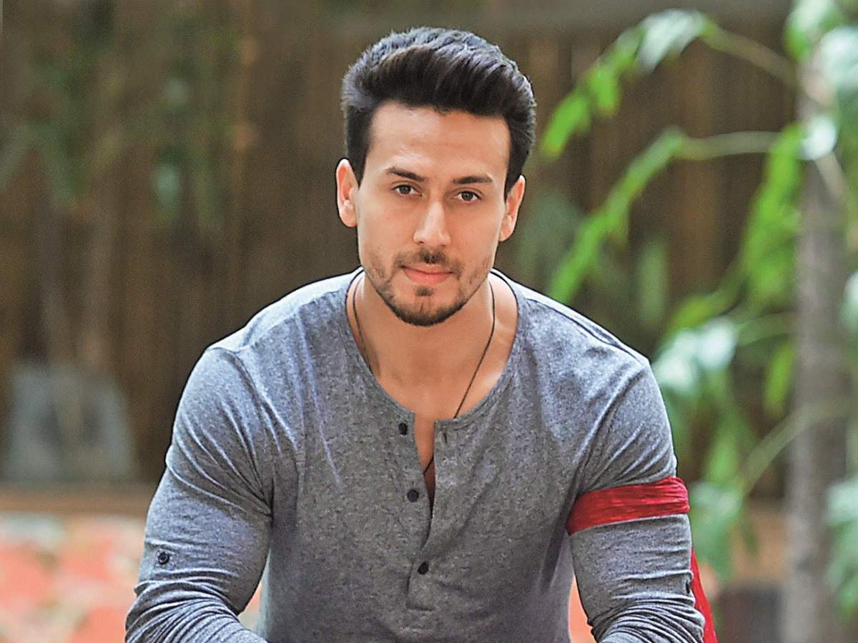
DECATHLON
TAGLINE-BE A SPORTSPERSON
I WANT TIGER SHROFF TO BE THE AMBASSADOR.

Slide 3
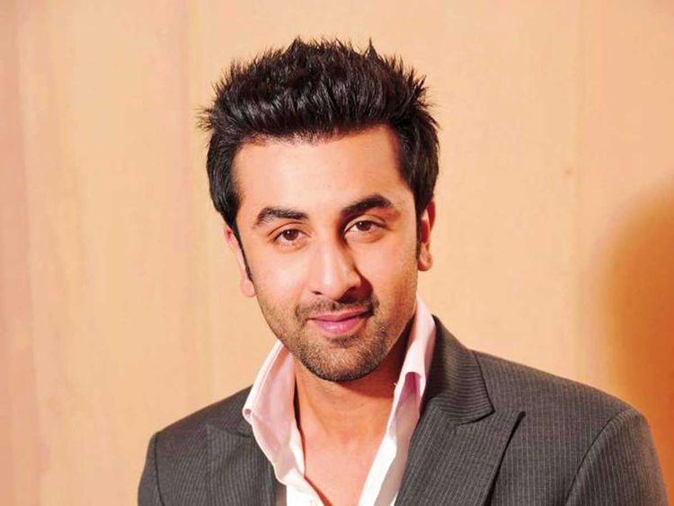
MANYAVAR
TAGLINE-BE TRENDY AND STYLISH
I WANT RANBIR KAPOOR TO BE THE AMBASSADOR

Slide 4
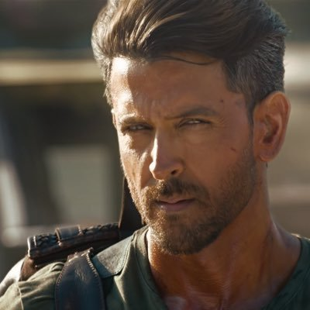
RAYMOND
TAGLINE-THE SUIT WILL SUIT YOU
I WANT HRITHIK ROSHAN TO BE THE AMBASSADOR

Slide 5
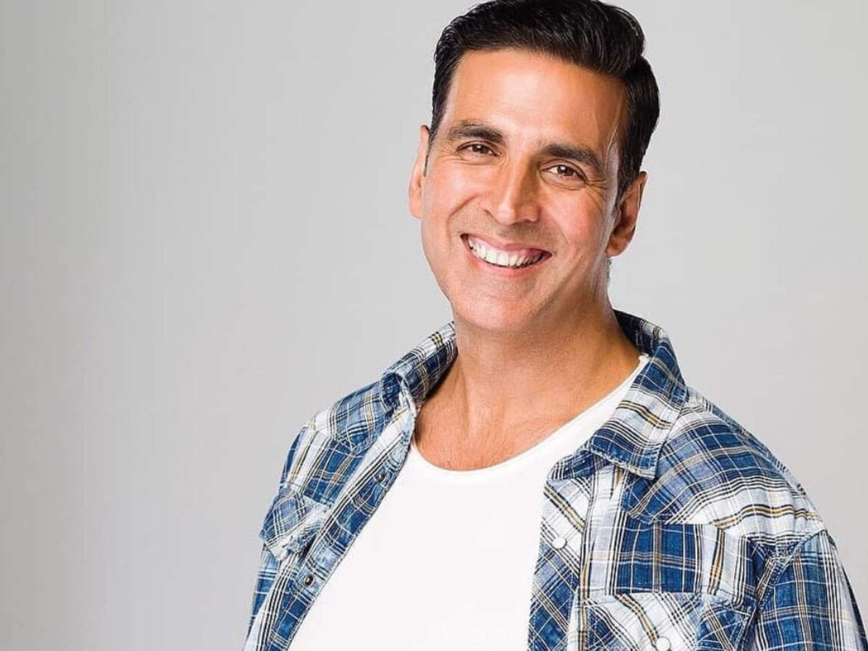
ALLEN SOLLY
TAGLINE-PROUD TO BE A MAN
I WANT AKSHAY KUMAR TO BE THE AMBASSADOR

Slide 6
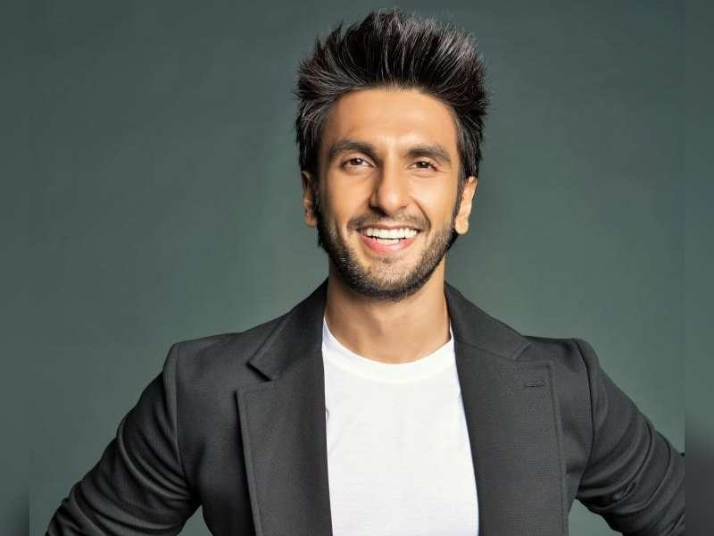
GINI AND JONY
TAGLINE-SWEET, TRENDY AND STYLISH
I WANT RANVEER SINGH TO BE THE BRAND AMBASSADOR

